Slide 1

WPU School of Computer Science and Engineering
Department of Computer Science and Applications
Full-Time Industry Internship Progress Report
(
Jan 2024 –June
2024)
SYMCA Science (Batch 2022-24) Semester IV
Nikhil Bhandari
PRN : 1132220050
A. Y. 2023-24

Slide 2
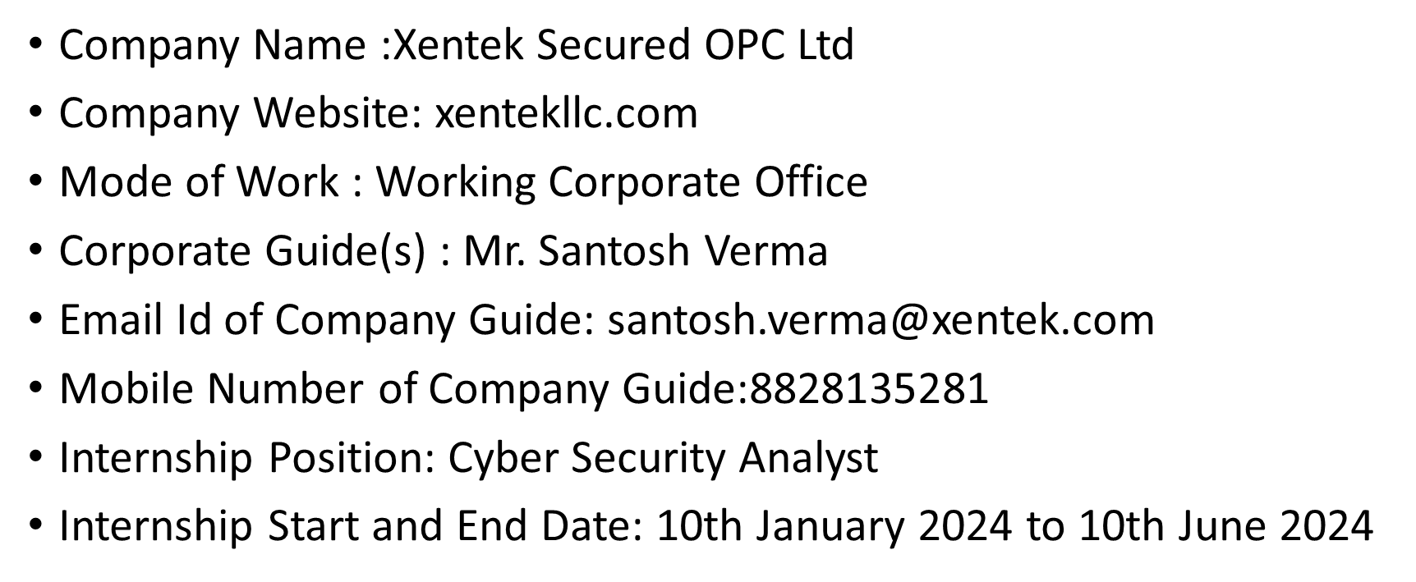
Internship details:

Slide 3
Work Day at internship:
10:00 am – Report to Manager.
10:15 am – Discussion on what we worked yesterday and what’s the plan for the day.
10:30 am – Start Working.
1.] Updating the System.
2.] Updating the Tools / Softwares.
3.] Run Deep Scans
12:00 pm – Lunch break
1:00 pm – Resume work.
1.] Go Through Scan Results.
2.] Take note of bugs/errors.
3.] Take necessary action to resolve the issue.
5:00 pm – Updating the work done on particular day and plan out next day plan to proceed further.
5:30 pm – Log Off.

Slide 4
Objective and Tasks Assigned
Sr No. | Task assigned | Start date | End date | Current status | Feedback
1 | Networking Overview, Linux History | 20/01 | 27/01 | Complete | -
2 | Linux and Windows Hands On | 29/01 | 03/02 | Complete | -
3 | Linux Commands | 04/02 | 08/02 | Complete
4 | Domain Registration, Email Attacks | 11/02 | 15/02 | Complete
5 | Introduction to Hacking, Lab Setups | 18/02 | 22/02 | Complete | Made some configuration changes
6 | Reconnaissance, Identity Theft | 25/02 | 29/02 | Complete | -
7 | Vulnerability Assessment and Penetration Testing Introduction | 01/03 | 05/03 | Complete | -
8 | Lab Setup | 08/03 | 10/03 | Complete | -
9 | Scanning using Nmap, Nessus | 15/03 | 20/03 | Complete | -
10 | Burp Suite | 22/03 | 26/03 | Complete | -

Slide 5
Work Details:-
Learnt basics of networking, OS and VAPT.
Learnt how to use professional tools like : Nessus Scanner, Acunetix, Burp Suite, Metasploit.
Learnt how to implement these tools for VAPT.
Learnt how to use inbuilt tools in Kali Linux for the purpose of testing Web Apps.
Learnt how to scan a WordPress website and find vulnerabilities.
Learnt and understood how the exploits work.
Learn about various new tools for cracking passwords of different types of files using John The Ripper and Hash Cat.
With the above knowledge, I completed my CEH certification.

Slide 6
Key Learnings (Technology)
Linux
Burp Suite
Acunetix
Nessus
Metasploit
Key Learnings(Behavioural)
Communication skills
Team meetings
Adaptability
Time management

Slide 7
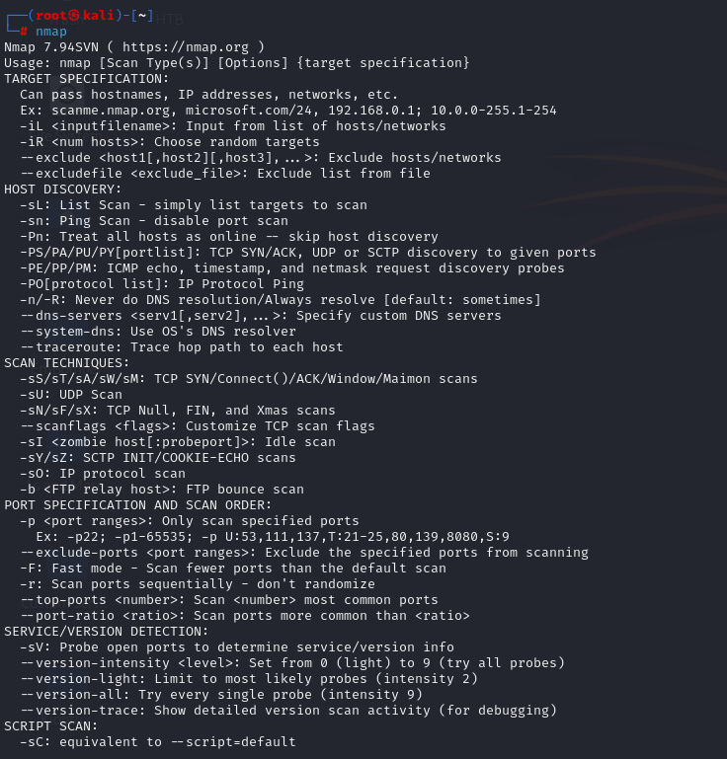
Screens:-

Slide 8
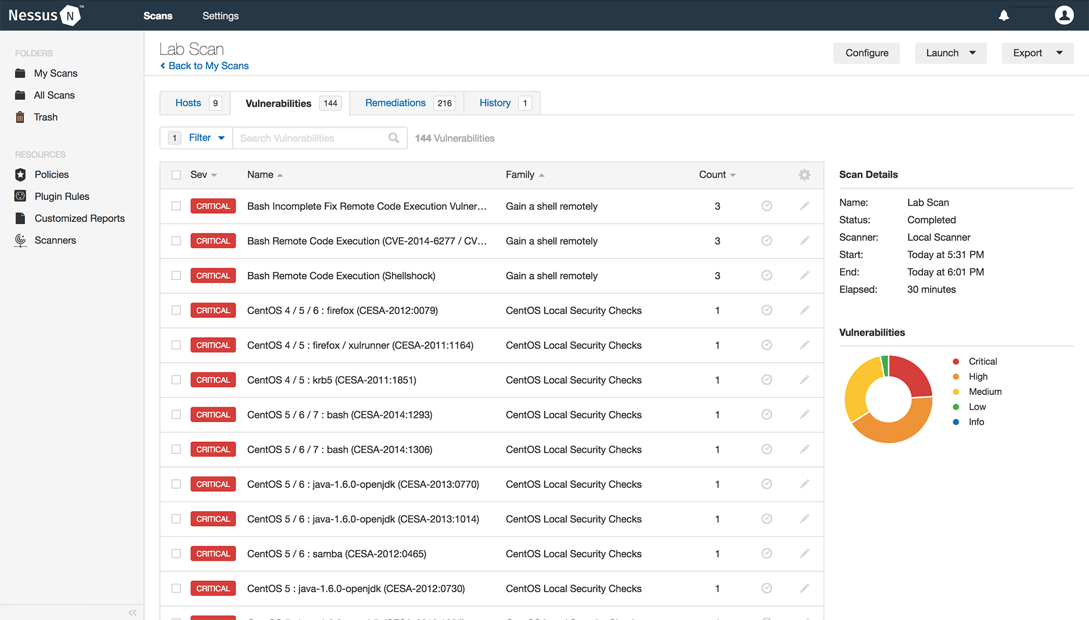

Slide 9
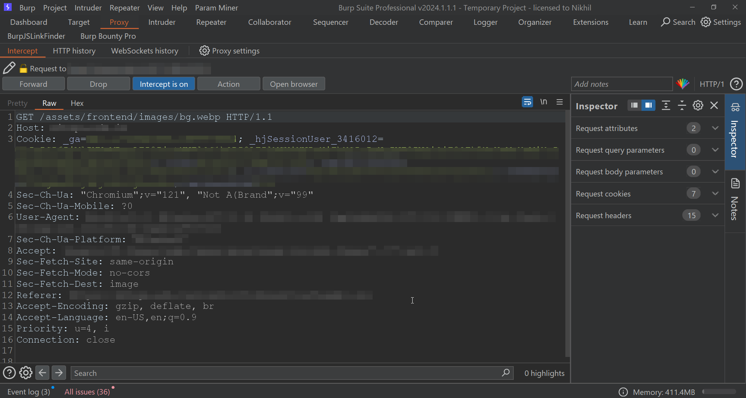

Slide 10
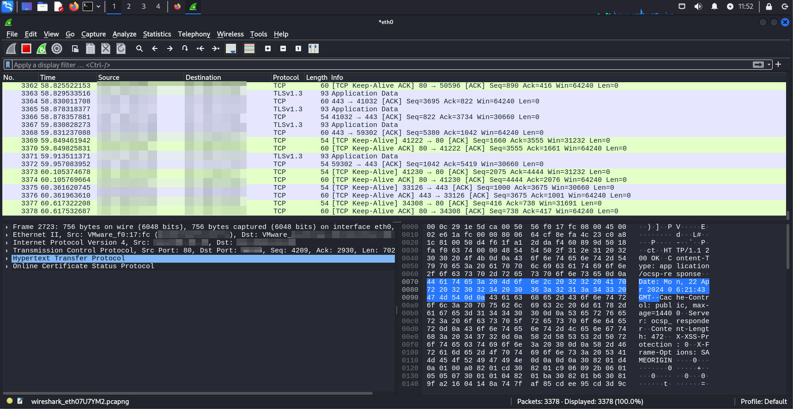

Slide 11
Thank you ☺

